Slide 1

EcoRide
Data Management and Warehousing
Team Members:
Angela Zhang
Jaloliddin Akhmedov
Iva Dodikj
Prof. Alessio Saltarin
March 24, 2026

Slide 2
The Vision
The Architectural Challenge
Neo-Metropolis is transitioning to a smart, sustainable urban infrastructure. EcoRide serves as the backbone of this green initiative, providing seamless mobility through a massive fleet of standard and electric bicycles.
Our role as Database Architects was to design a robust relational schema capable of supporting:
Real-Time Inventory Management: Tracking thousands of bike assets across a network of hundreds of docking stations.
Data Integrity & Consistency: Implementing strict constraints to ensure a "single source of truth" (e.g., preventing a bike from being docked in two locations simultaneously).
Operational Logistics: Modeling complex relationships for various subscription tiers, pay-as-you-go transactions, and fleet maintenance.
Analytical Readiness: Structuring data to allow for ride pattern analysis and optimized bike distribution.
Scale & Performance Metrics
10,000+ | 99.9% | Real-Time
Bikes Supported | Data Integrity | Fleet Monitoring

Slide 3
Conceptual Design
Model Notation
Chen’s Entity-Relationship
System Integrity
3rd Normal Form (3NF)
Operational Nexus
‘Ride’ Central Entity

Slide 4
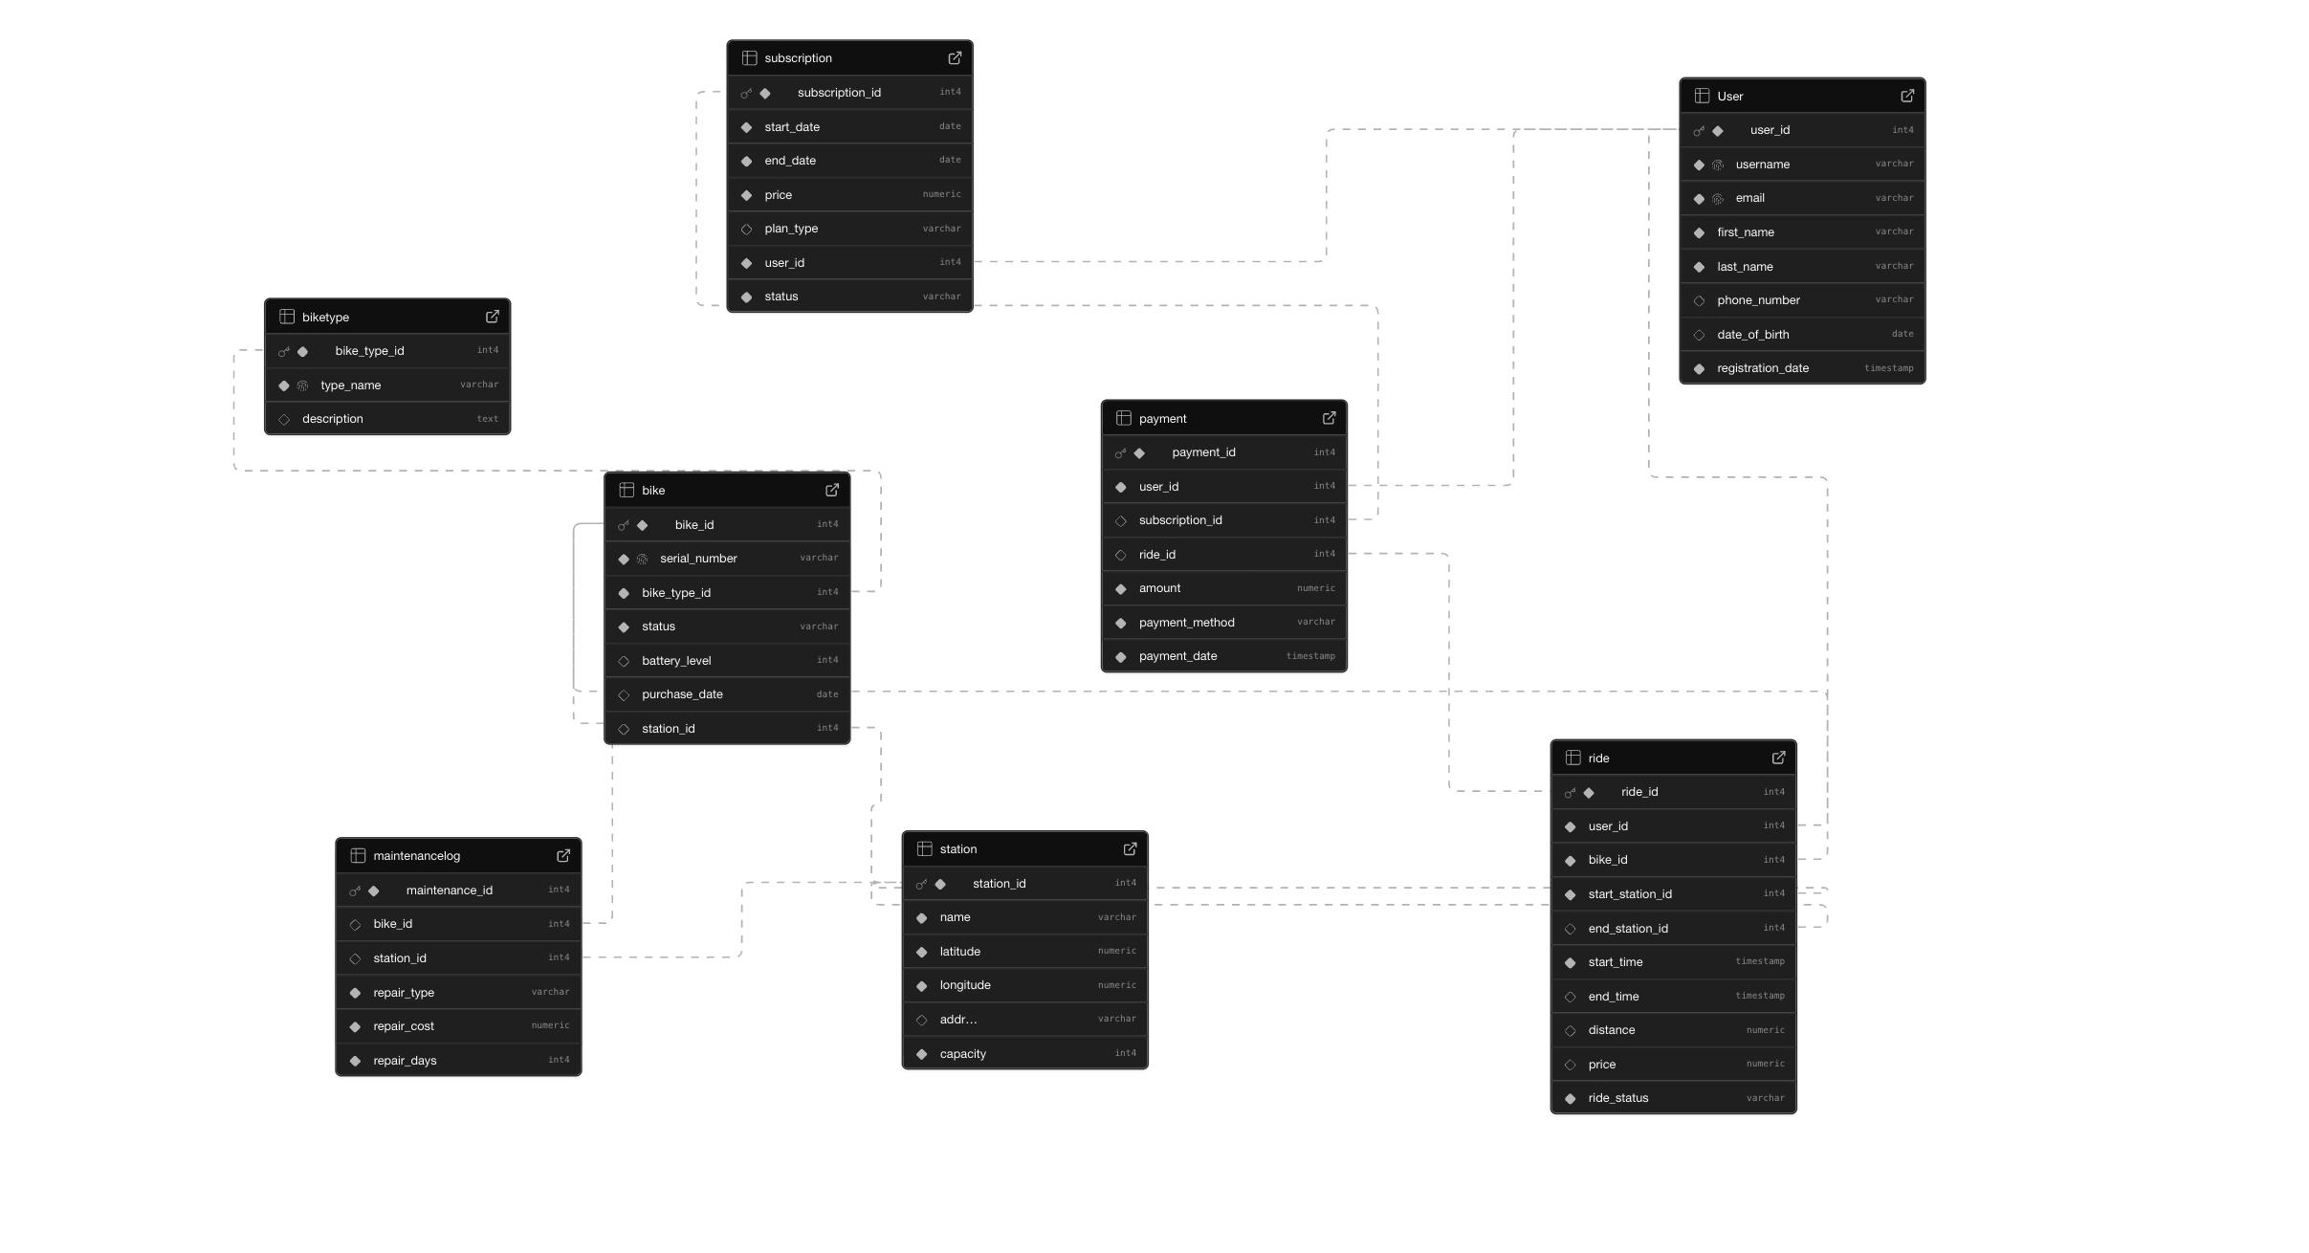
Logical Design
Schema Inventory
9 Tables | 54 Attributes:
Normalized to 3NF
12 Foreign Keys:
Enforcing strict referential integrity.
Type Precision:
NUMERIC for financials & TIMESTAMP for audit logs.
Conditional Constraints:
Ensuring payment and maintenance integrity.

Slide 5
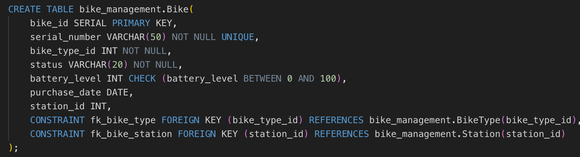
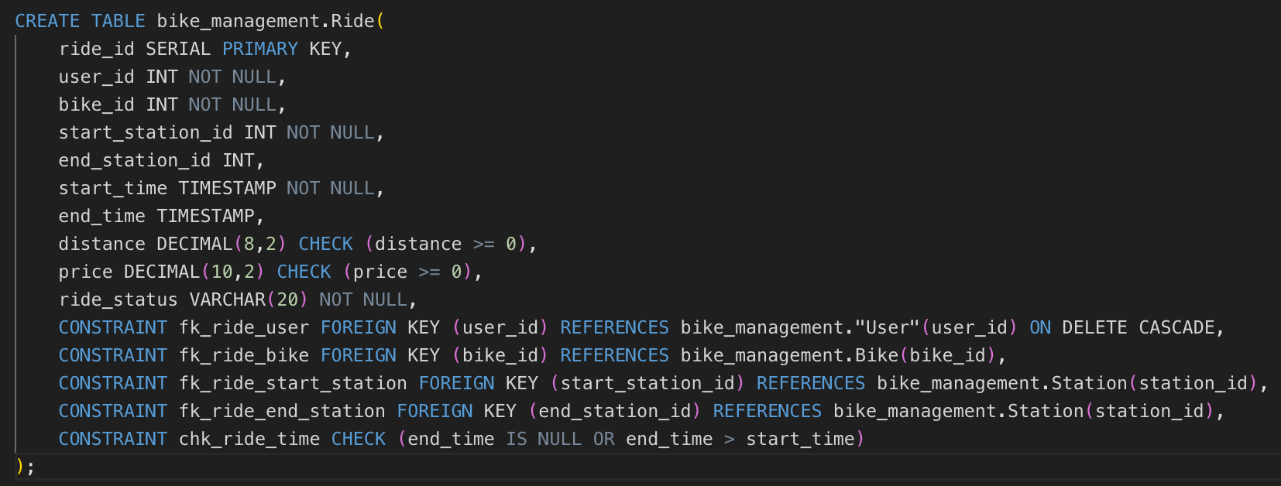
Physical Implementation: DDL & Constraints
Check Constraints: Enforcing battery levels and ride times.
Data Integrity: Unique serials and auto-incrementing PKs.
Referential Mapping: Foreign keys linking the ecosystem.
Timeline Validation: chk_ride_time ensures logical start and end sequences.

Slide 6
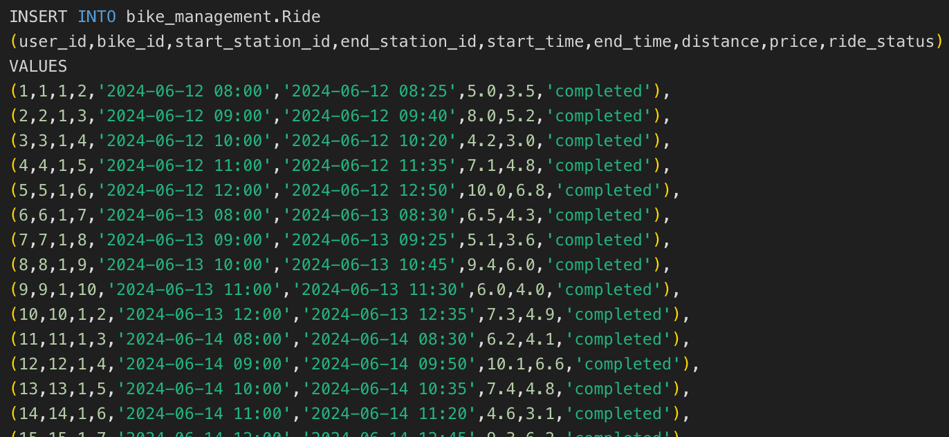
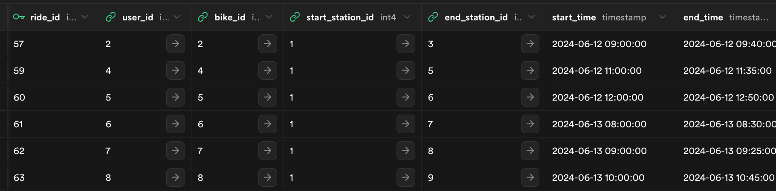
Database Population & DML Implementation
Multi-row transactional seeding for the Ride entity.
Post-execution state: Successful mapping of IDs and Timestamps.

Slide 7
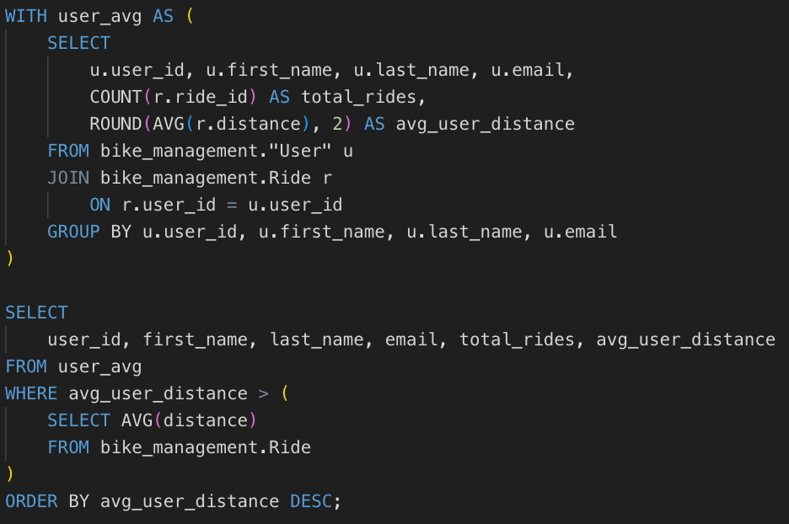
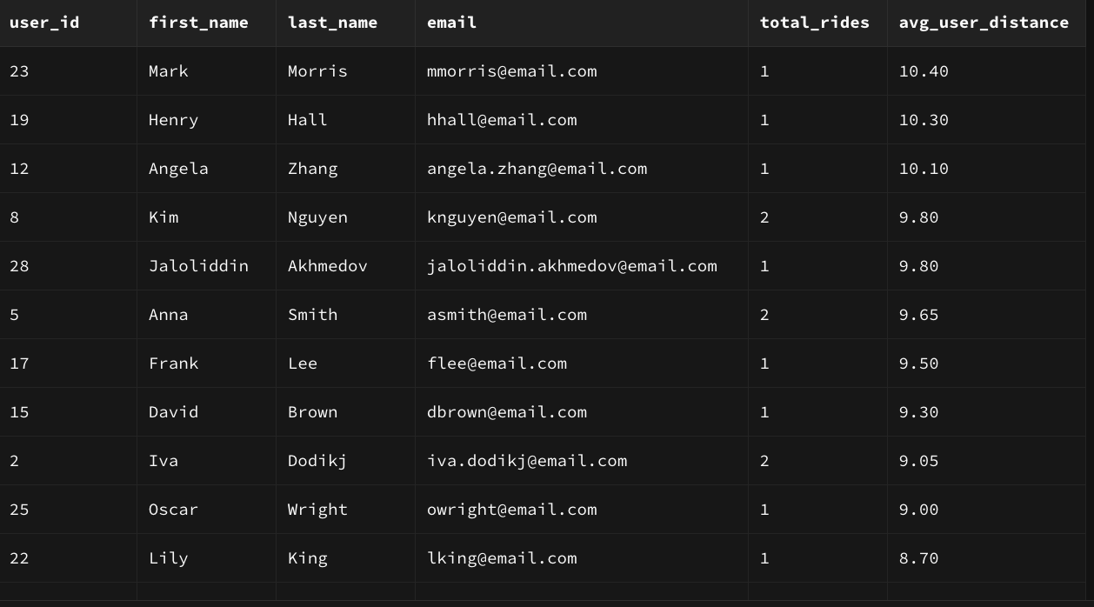
Advanced Data Analytics
Insight: Which users have ridden more than the average distance?
Logic Pattern
CTE & Subquery Implementation
Statistical Filter
Real-time Global Benchmarking
Business Value
Power-user Segment ID

Slide 8

Thank you for your attention!
Any questions?

